Slide 1
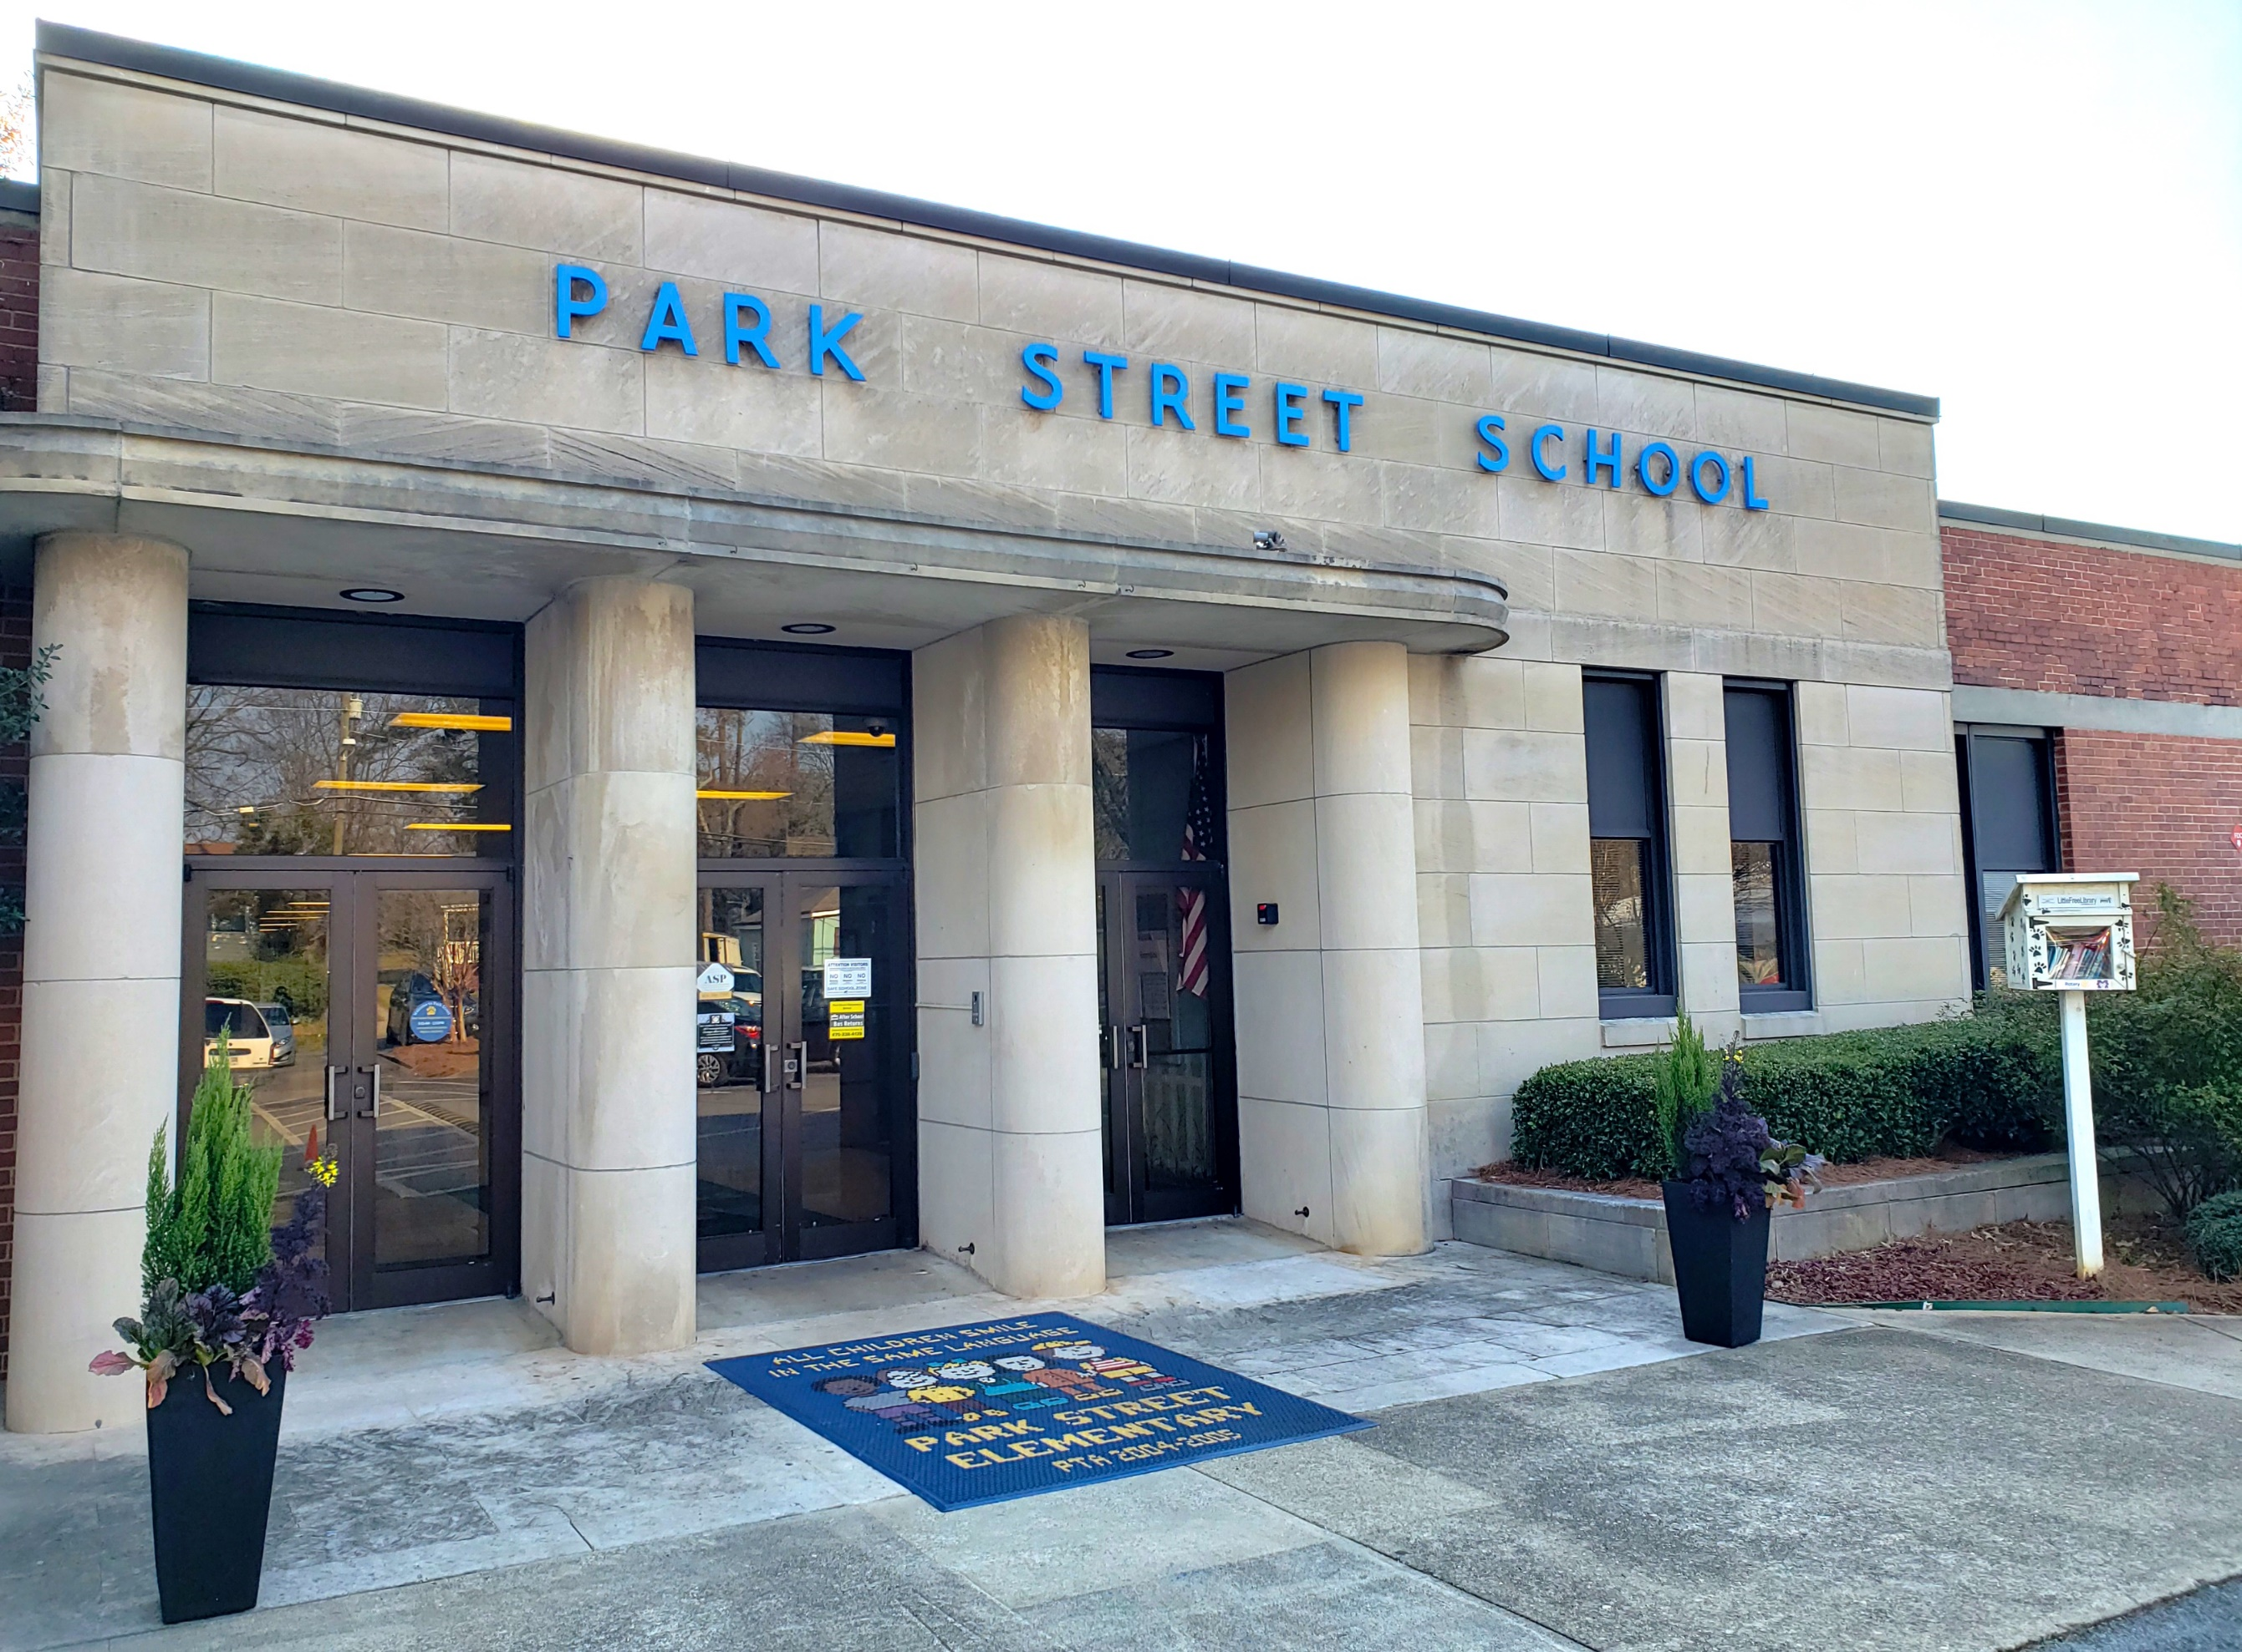

P
S
E
S
A
R
K
T
R
E
E
T
L
EM
E
NTA
R
Y
C
H
OO
L

Slide 2
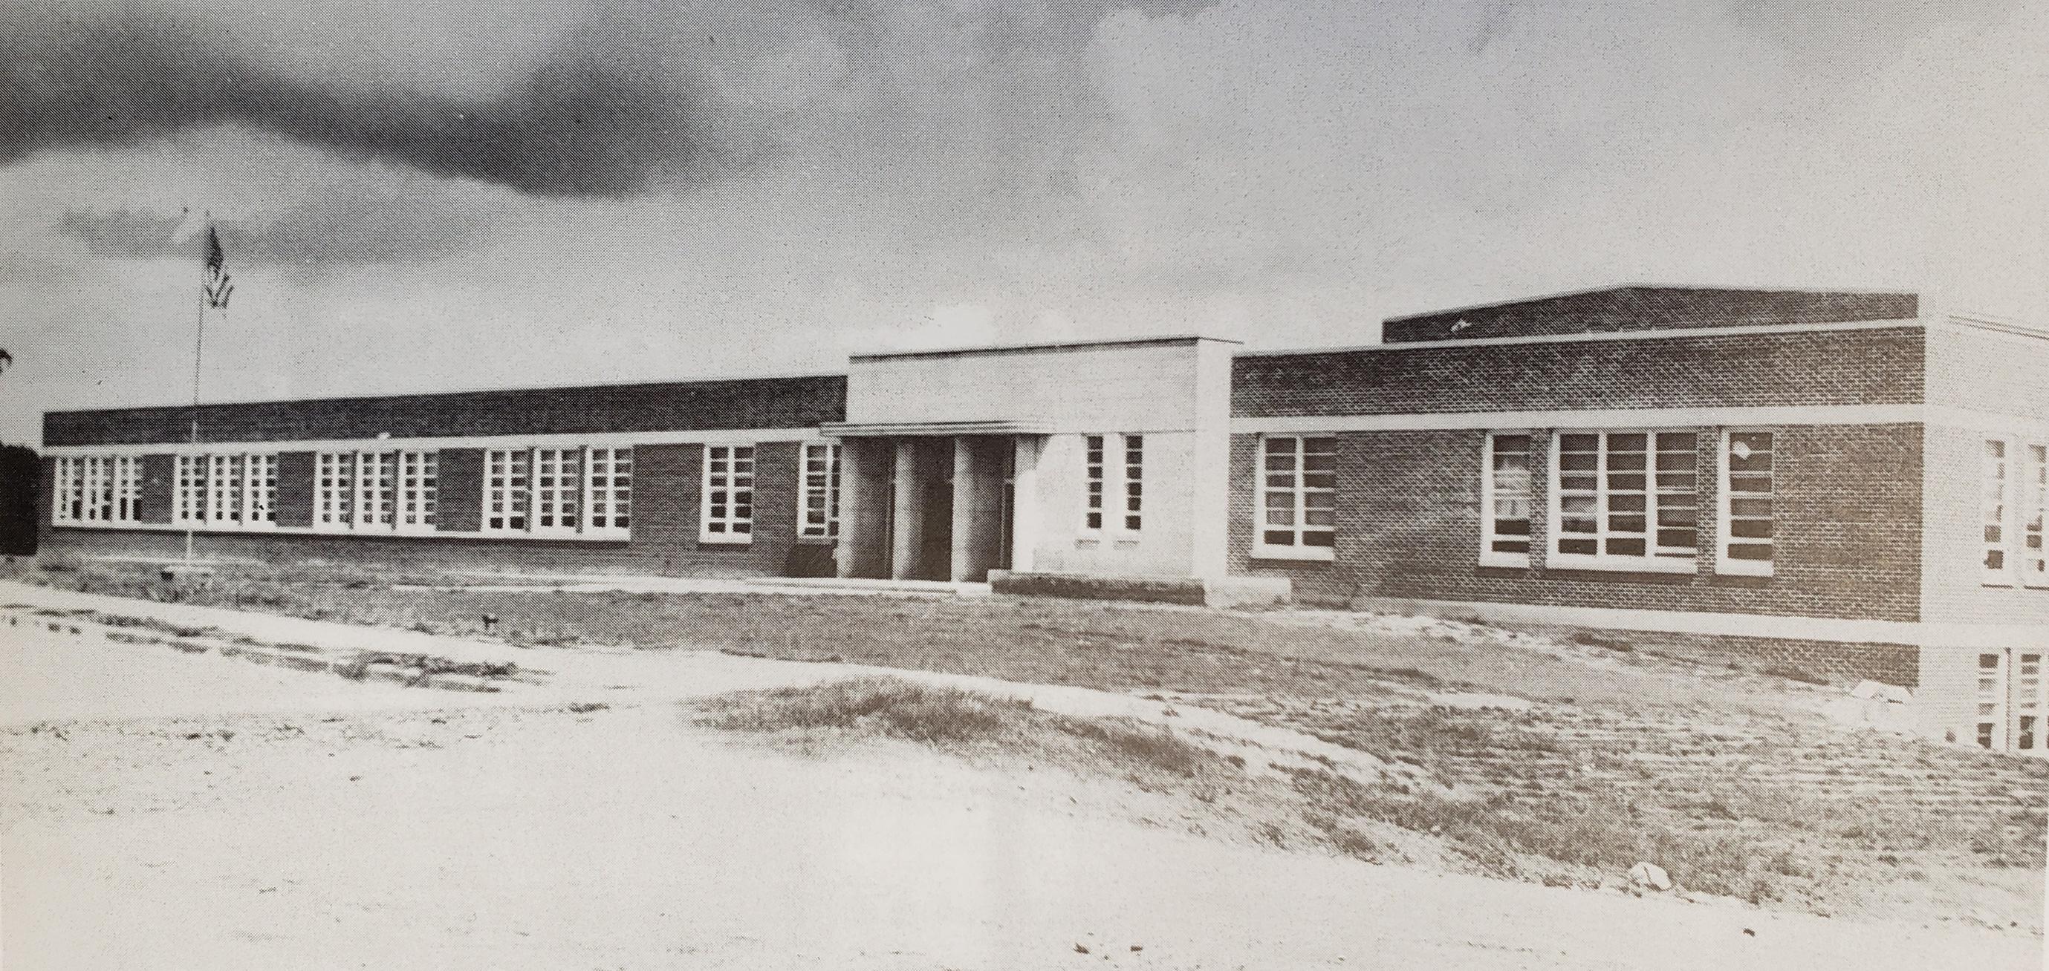
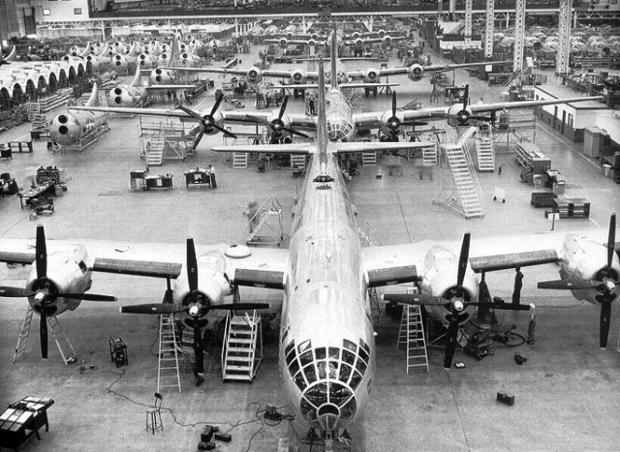
P
S
E
S
A
R
K
T
R
E
E
T
L
EM
E
NTA
R
Y
C
H
OO
L
During WWII, Bell Aircraft established a plant in Marietta to build B-29 bombers for the US Air Force. The plant opened in 1943
In 1940, Marietta had a population of 8,700. In February, 1944 the Marietta Bell Aircraft Corporation rolled out it’s first B-29 bomber and employed over 28,000 workers by February of 1945
Opened in 1944
Park Street Elementary School opened in 1944. It was built to accommodate the population boom resulting from the aircraft manufacturing plant

Slide 3
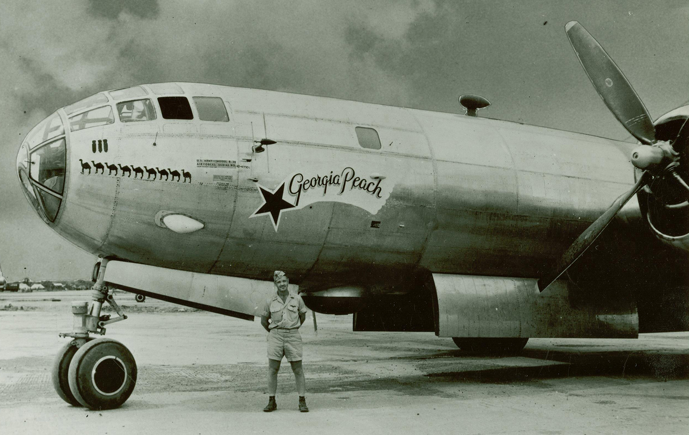
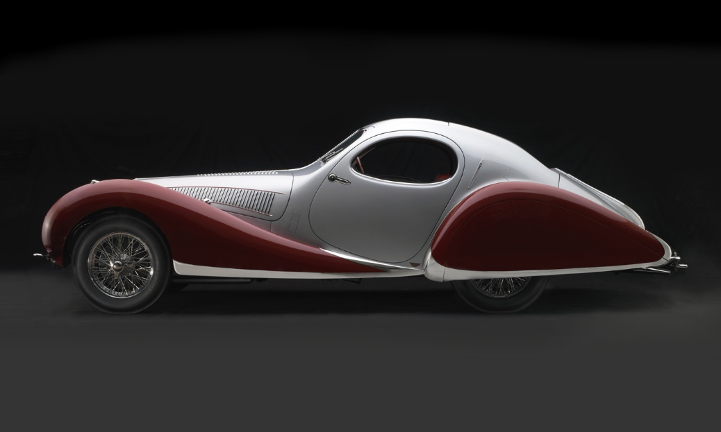
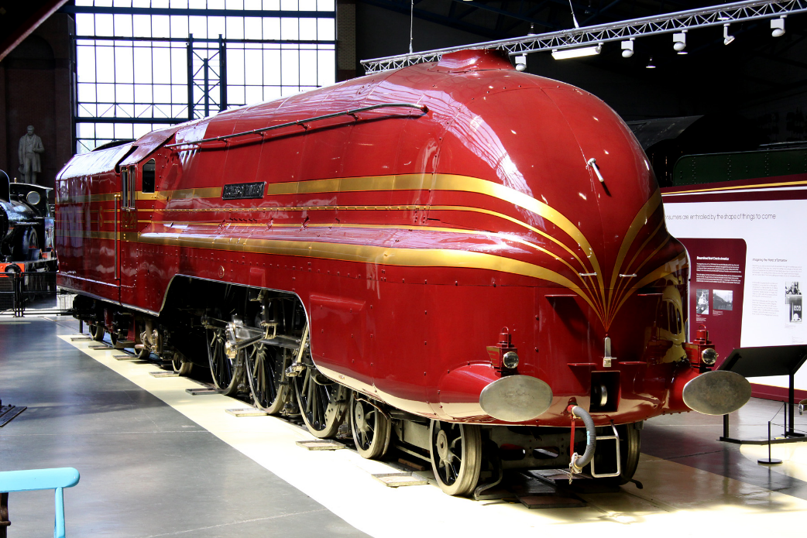
STREAMLINE MODERNE INDUSTRIAL DESIGN
The Bell B-29 Bomber was heralded for its futuristic technology and its streamline, modern design
Art Deco – Late 1920’s to 1930’s
Streamline Modern – 1930’s to 1940’s
Design Period Timeline

Slide 4
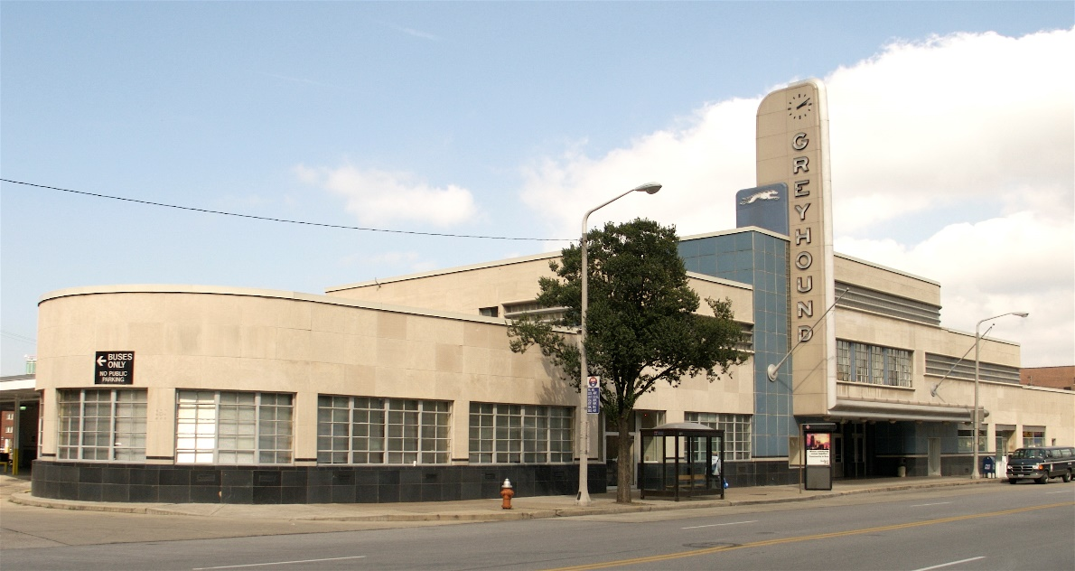
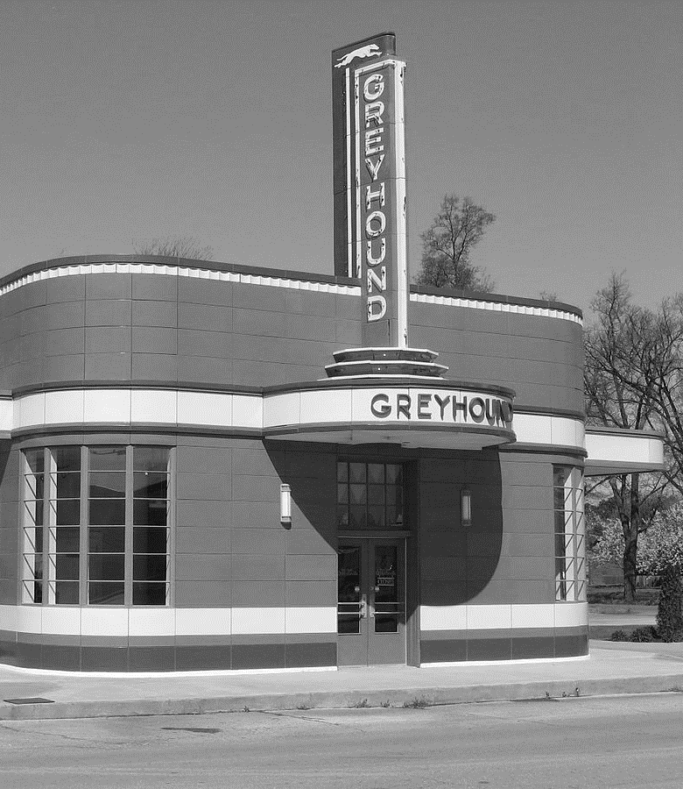
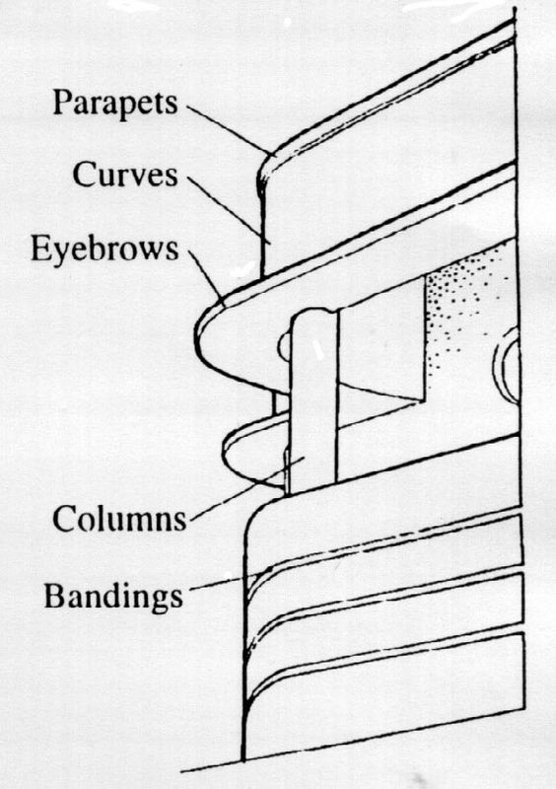
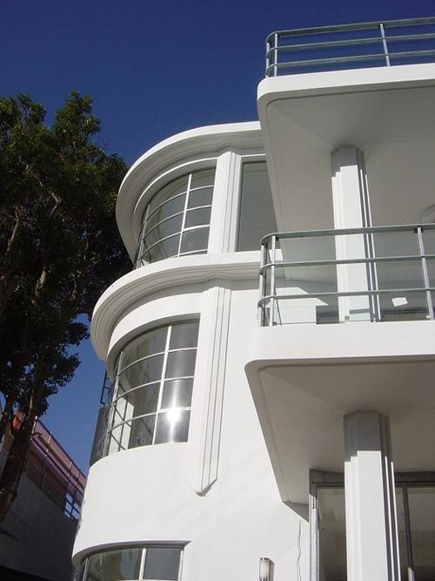
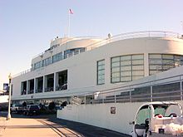
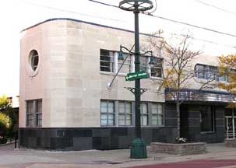
STREAMLINE MODERNE ARCHITECTURAL DESIGN
Art Deco – Late 1920’s to 1930’s
Streamline Modern – 1930’s to 1940’s
Design Period Timeline
Notes:
Streamline Moderne is an international style of Art Deco architecture and design that was inspired by aerodynamic design. Streamline Moderne Architecture emphasized curving forms, long horizontal lines and sometimes nautical elements. In Industrial design it was used in railroad locomotives, automobiles, aircrafts and ships to give the impression of sleekness and modernity.

Slide 5

